Slide 1
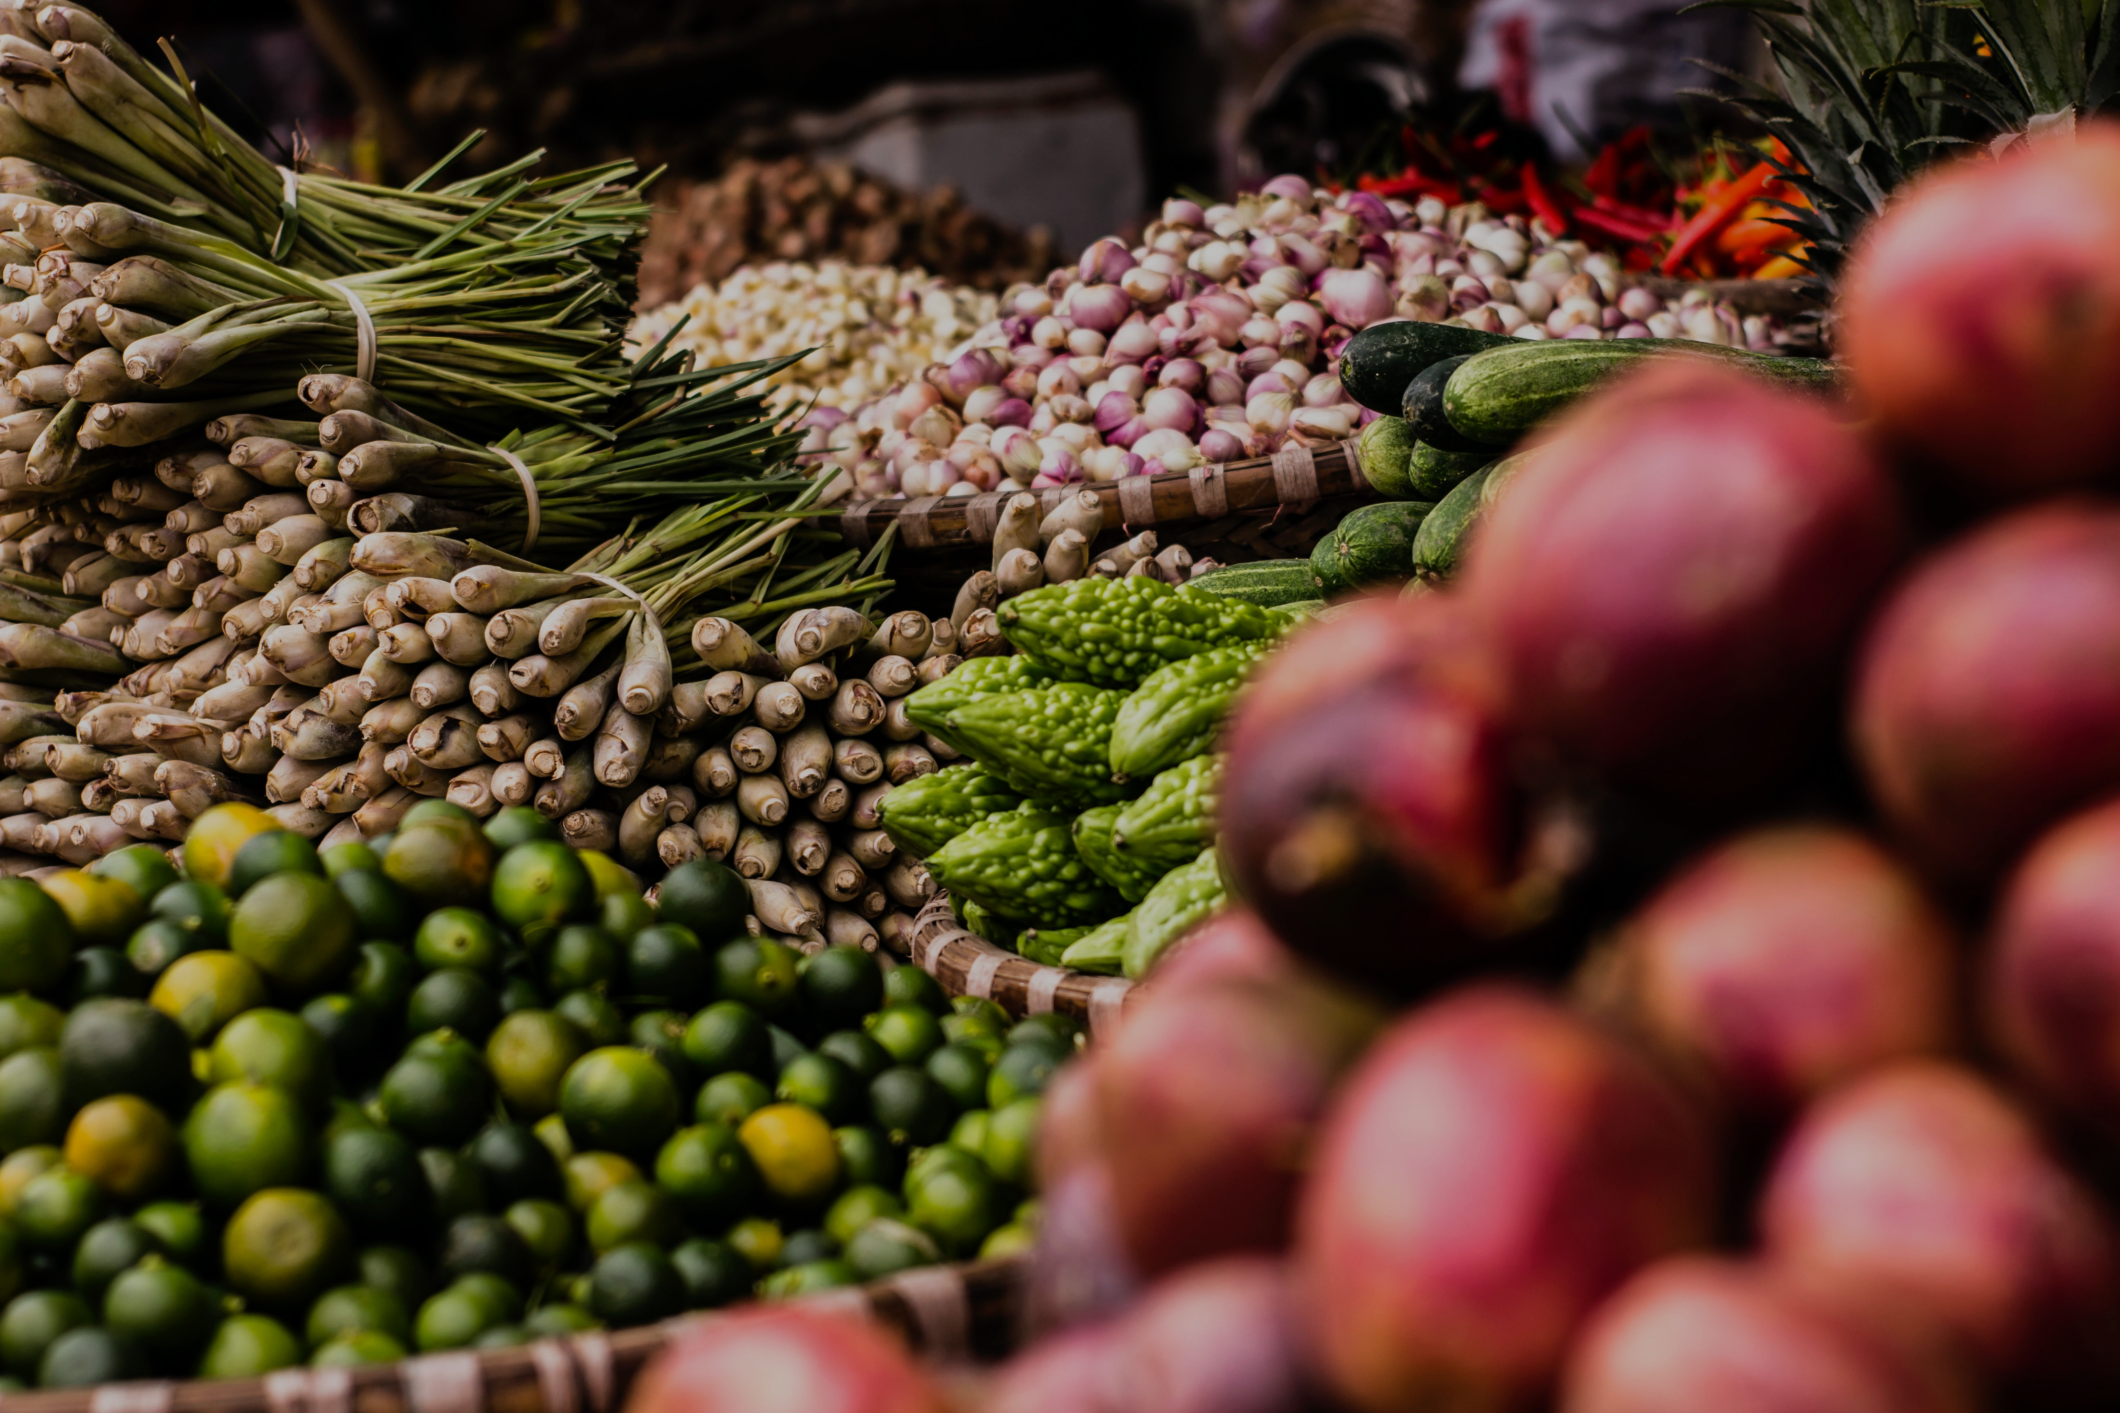

Food Loss and Waste
Slides and Figures
Photo by Julian Hanslmaier/Unsplash

Slide 2
A significant share of food intended for human consumption is lost or wasted from the farm to the fork
32%
of global food supply by weight
24%
of global food supply by energy content (calories)
Source: WRI analysis based on FAO. 2011. Global food losses and food waste – extent, causes and prevention. Rome: UN FAO.

Slide 3

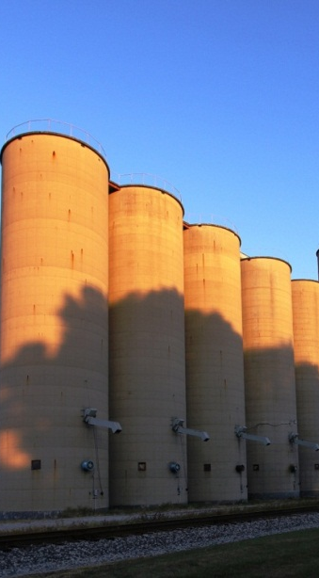
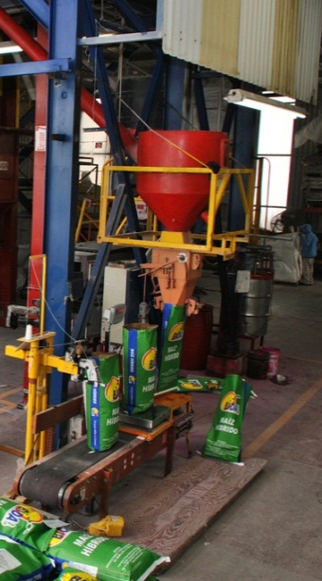
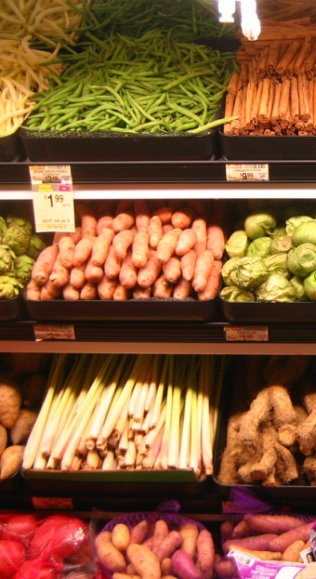
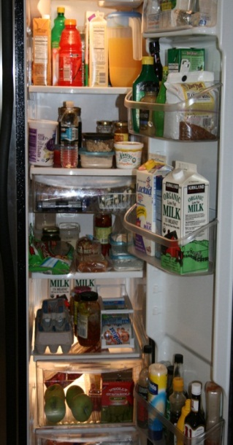
Food is lost or wasted along the entire value chain
During or immediately after harvesting on the farm
After leaving the farm for handling, storage, and transport
During industrial or domestic processing and/or packaging
During distribution to markets, including at wholesale and retail markets
In the home or business of the consumer, including restaurants and
caterers
Source: WRI analysis based on FAO. 2011. Global food losses and food waste – extent, causes and prevention. Rome: UN FAO.

Slide 4
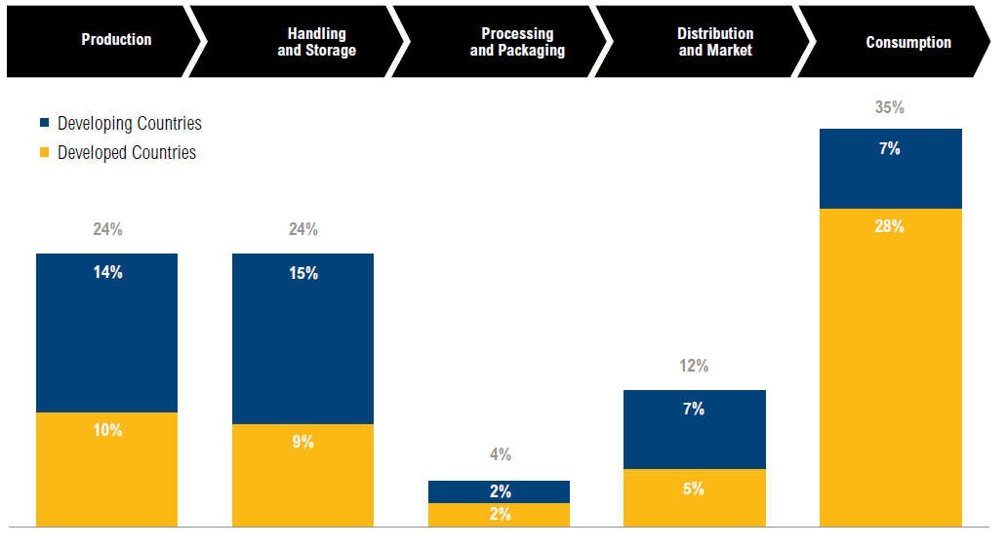
Food loss and waste occurs more ‘near the fork’ in developed regions and more ‘near the farm’ in developing regions
100% = 1.5 quadrillion kcal
Source: WRI analysis based on FAO. 2011. Global food losses and food waste – extent, causes and prevention. Rome: UN FAO.

Slide 5
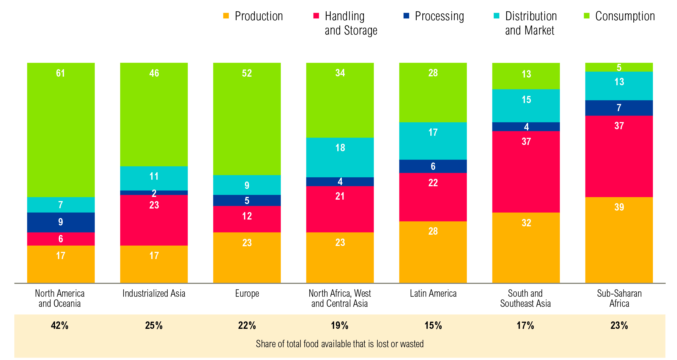
Losses at production are more prevalent in developing regions while food waste at consumption is more prevalent in developed regions
(Percent of kcal lost and wasted)
Note: Number may not sum to 100 due to rounding.
Source: WRI analysis based on FAO. 2011. Global food losses and food waste – extent, causes and prevention. Rome: UN FAO.

Slide 6
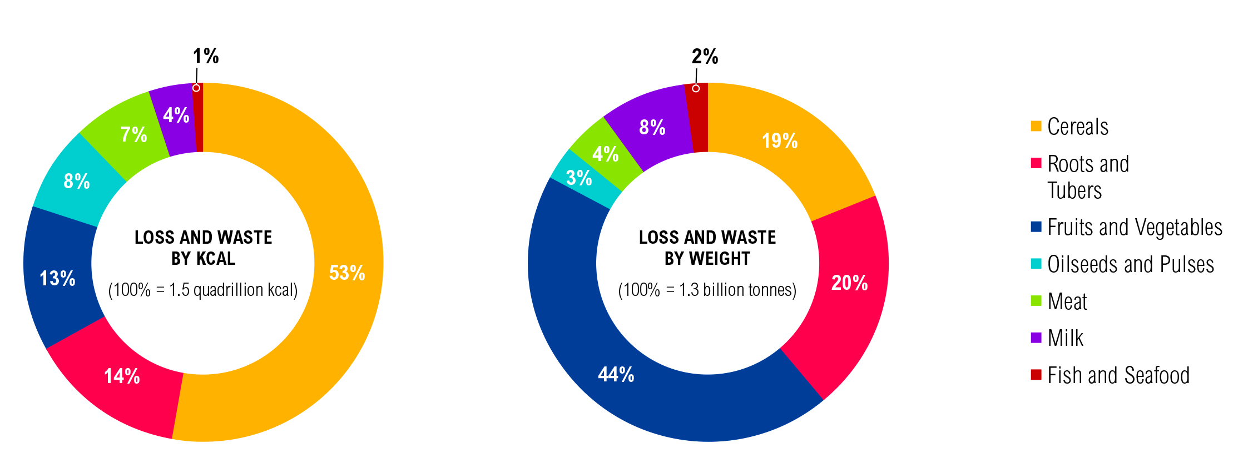
Cereals comprise the most loss and waste when measured by calories, while fruits and vegetables by weight
Source: WRI analysis based on FAO. 2011. Global food losses and food waste—extent, causes and prevention. Rome: UN FAO.

Slide 7
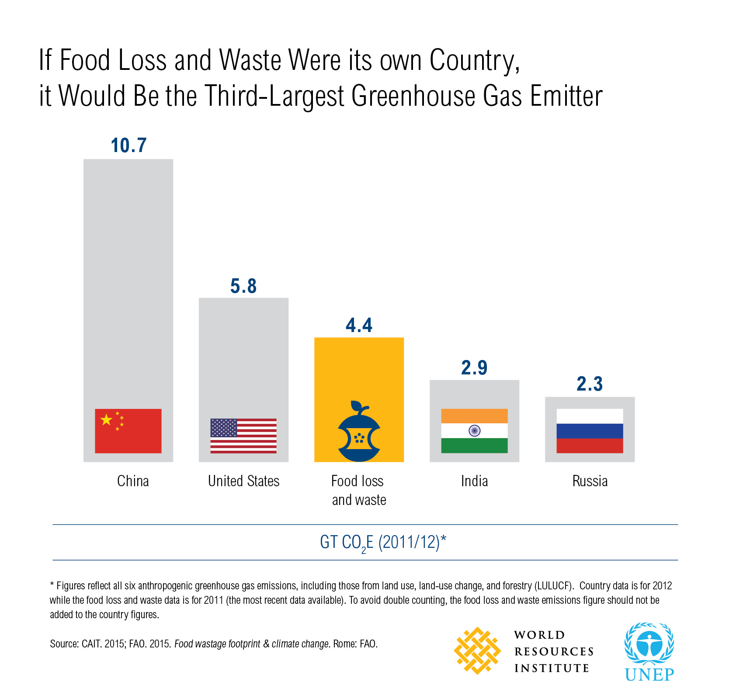

Slide 8


  TARGET 12.3
  By 2030, halve per capita global food waste at the retail and consumer levels and reduce food losses along production and supply chains, including post-harvest losses.

Slide 9

Champions 12.3 is a unique coalition of leaders dedicated to inspiring ambition, mobilizing action, and accelerating progress toward achieving SDG Target 12.3

Slide 10

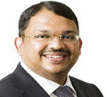


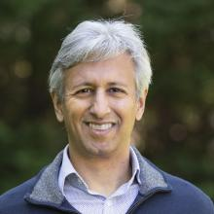


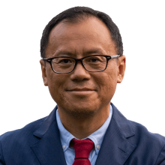


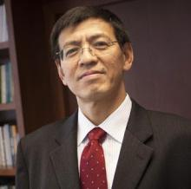









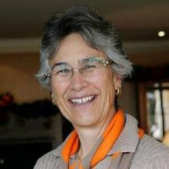
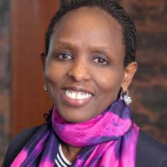


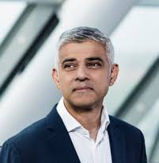





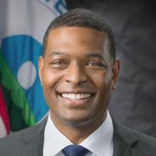



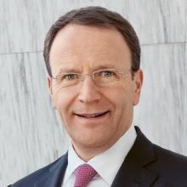
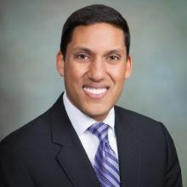
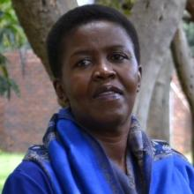





Hans Hoogeveen
Independent Chairperson of the Council, FAO
Co- Chair, Champions 12.3
Sunny Verghese
CEO and Co-Founder
Olam International
Co- Chair, Champions 12.3
Inger Andersen
Executive Director
UN Environment
Peter Bakker
President
World Business Council for Sustainable Development
Manish Bapna
President & CEO
NRDC
Sophie Bellon
CEO
Sodexo
Steven Cahillane
CEO
Kellogg Company
Wai-Chan Chan
Managing Director
Consumer Goods Forum
Nguyen Xuan Cuong
Minister of Agriculture & Rural Development
Vietnam
Stefaan Decraene
Chairman of the Managing Board
Rabobank
Shenggen Fan
Chair Professor
China Agricultural University
Kevin Fay
Executive Director
Global Food Cold Chain Council
Maneesh Gobin
Minister of Agro-Industry and Food Security
Republic of Mauritius
Lorena Lourido Gomez
Global Food Manager,
Ingka Group
Liz Goodwin
Senior Fellow and Director, Food Loss and Waste
World Resources Institute
Sjoukje Heimovaara
President of the Executive Board
Wageningen University
& Research
Gilbert F. Houngbo
Director-General
International Labor Organization
Jacob Jensen
Minister for Food, Agriculture and Fisheries
Denmark
Hanneke Faber
Business Group President, Nutrition
Unilever
Selina Juul
Chairman of Board & Founder
Stop Wasting Food
Yolanda Kakabadse
Member
WWF US
Board of Directors
Agnes Kalibata
President
AGRA
Sam Kass
Founder
TROVE Acre & Venture Partners
Michael Keller
Secretary General
International Seed Federation
Sadiq Khan
Mayor
London, UK
Stella Kyriakides
Commissioner for Health and Food Safety
European Commission
Harriet Lamb
CEO
WRAP
Alvaro Lario
President
International Fund of Agricultural Development
Geraldine Matchett
Co-CEO, CFO, Member of the Managing Board
DSM
Ken Murphy
Group Chief Executive
Tesco
Michael S. Regan
Administrator
U.S. Environmental Protection Agency
Demba Sabally
Minister of Agriculture
Republic of Gambia
Josefa Leonel Correa Sacko
Commissioner for Rural Economy and Agriculture
African Union
Oyun Sanjaasuren
Director of External Affairs
Green Climate Fund
Mark Schneider
CEO
Nestlé S.A.
Rajiv Shah
President
Rockefeller Foundation
Lindiwe Majele Sibanda
Co-Chair
Global Alliance for Climate Smart Agriculture
Achim Steiner
Administrator
UNDP
Tristram Stuart
Co-Founder
Feedback
Johan Swinnen
Director General
IFPRI
Managing Director of Systems Transformation
CGIAR
Tom Vilsack
Secretary
U.S. Department of Agriculture (USDA)
Juergen Voegele
Vice President, Sustainable Development
World Bank

Slide 11
What Champions do…
Dedicate to SDG Target 12.3
Lead by example
Showcase successes
Advocate for enabling conditions
Achieve concrete results

Slide 12

Possible approaches for reducing food loss and waste (not exhaustive)
During or immediately after harvesting on the farm
After leaving the farm for handling, storage, and transport
During industrial or domestic processing and/or packaging
During distribution to markets, including at wholesale and retail markets
In the home or business of the consumer, including restaurants and
caterers
Provide information on how to use unmarketable crops | Improve storage technologies (e.g., evaporative coolers, storage bags, metal silos, crates) | Re-engineer manufacturing processes | Facilitate increased donation of unsold goods | Conduct consumer education campaigns
Improve agriculture extension services | Introduce low-carbon cold chains | Improve supply chain management | Provide guidance on food storage and preparation to consumers | Improve consumer cooking skills
Improve access to infrastructure and markets | Improve handling | Improve packaging to keep food fresher for longer and optimize portion size | Change food date labeling practices | Reduce portion sizes
Improve harvesting techniques | Improve infrastructure (e.g., roads) |  | Change in-store promotions | Eat “ugly” produce

Slide 13
Source: ReFED. 2016. A Roadmap to Reduce U.S. Food Waste by 20 Percent.

Slide 14
Source: ReFED. 2016. A Roadmap to Reduce U.S. Food Waste by 20 Percent.

